Slide 1

SIMULATION AND MODELING
DIKESH KATWAL
MSC CS

Slide 2
UNIT I
1.1 system, model and simulation

Slide 3
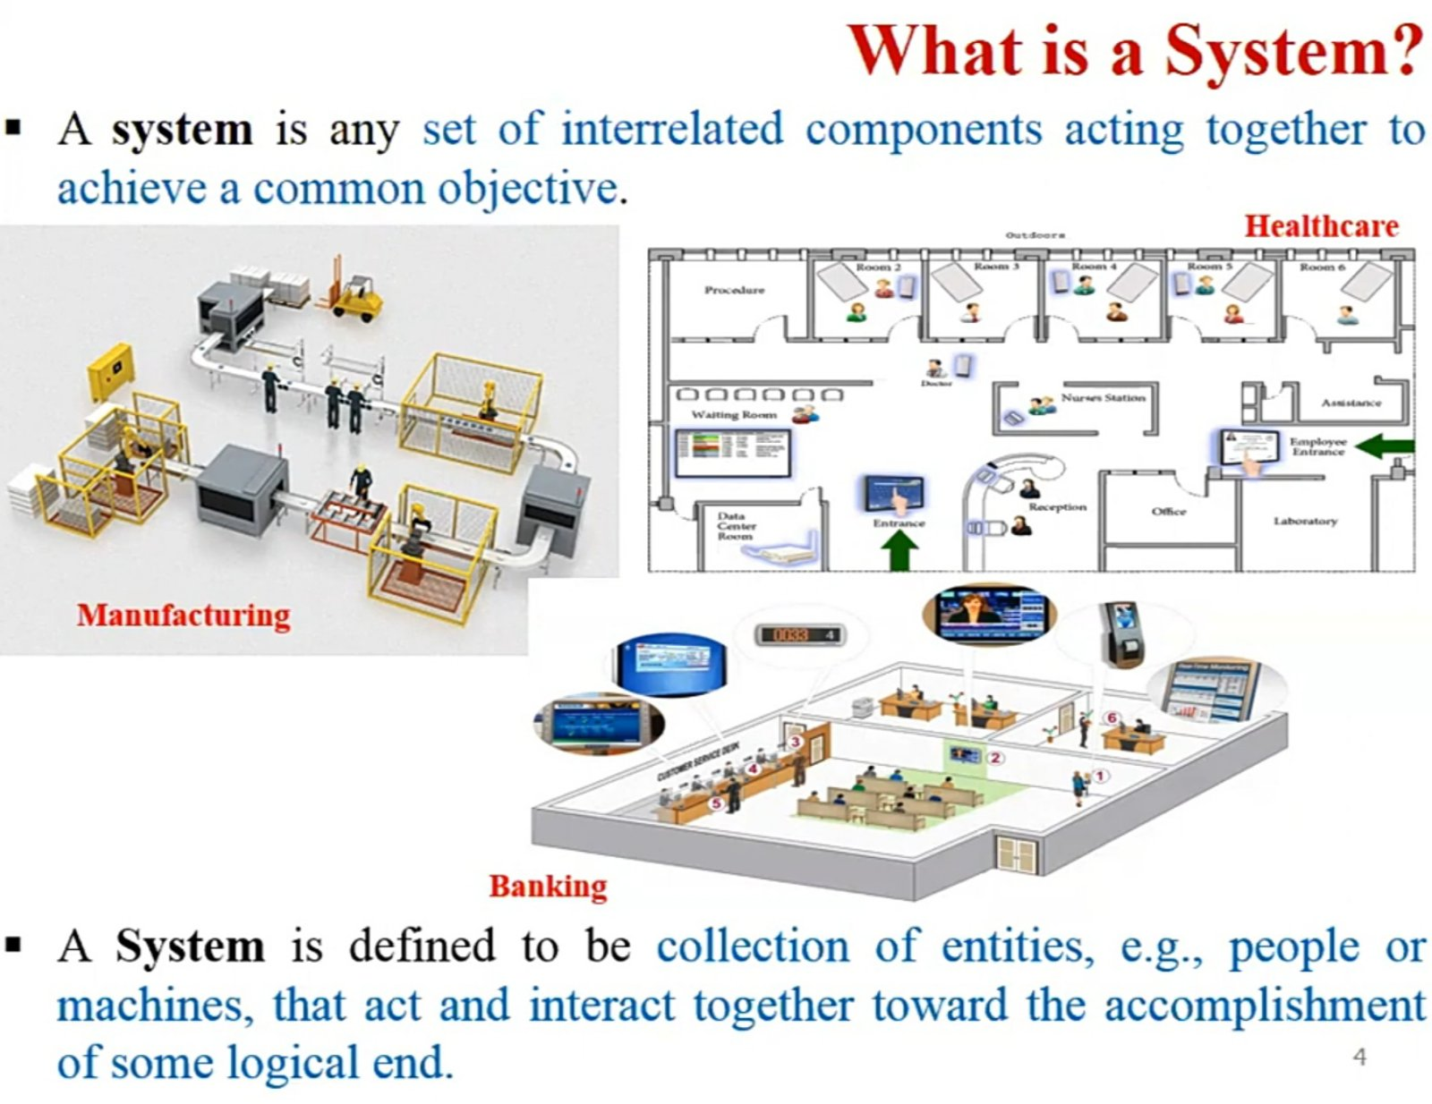

Slide 4
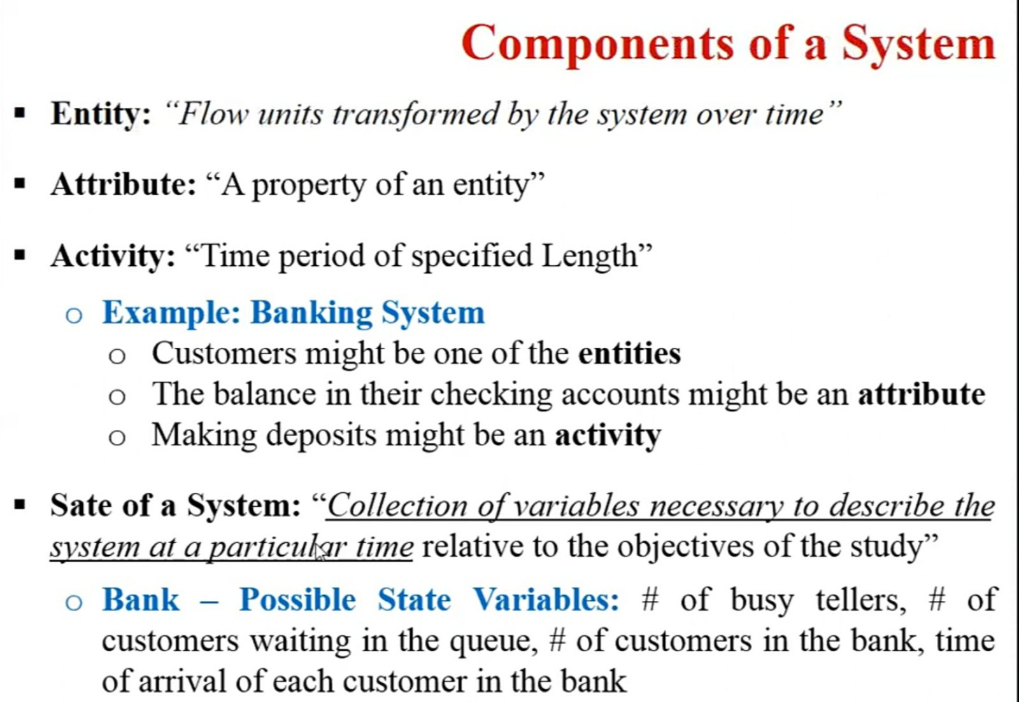
System

Slide 5
Compoents of a System..
Event
An event is define as an instaneous occurrence that may change the state of the system
System Environment
The external components which interact with the system and produce necessary changes are said to constitute the system environment.
• In modeling systems, it is necessary to decide on the boundary between the system and its environment. This decision may depend on the purpose of the study.
• Ex: In a factory system, the factors controlling arrival of orders may be considered to be outside the factory but yet a part of the system environment. When, we consider the demand and supply of goods, there is certainly a relationship between the factory output and arrival of orders. This relationship is considered as an activity of the system.

Slide 6
System Environment The changes occurring outside the system are said to occur in system environment
Endogenous System
The term endogenous is used to describe activities and events occurring within a system. Ex: Drawing cash in a bank.
Exogenous System
The term exogenous is used to describe activities and events in the environment that affect the system. Ex: Arrival of customers.
Closed System
A system for which there is no exogenous (No External) activity and event is said to be a closed. Ex: Water in an insulated flask.
Open system
A system for which there is exogenous(External) activity and event is said to be a open. Ex: Bank system

Slide 7
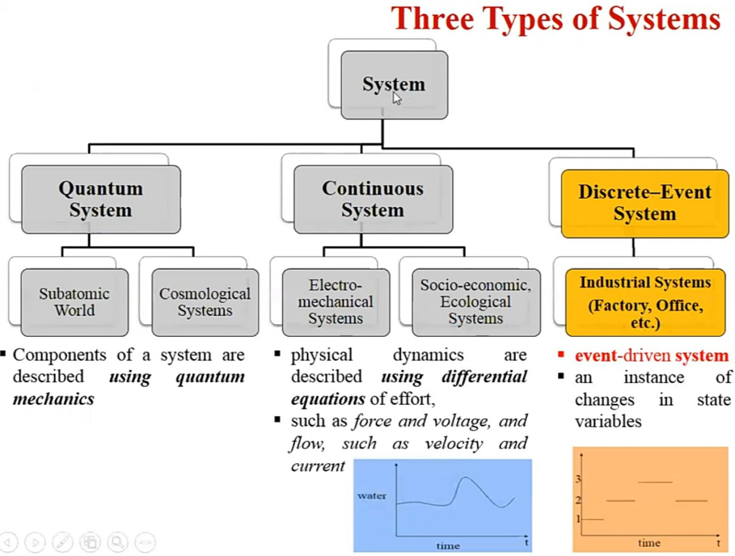

Slide 8
1.2 Discrete System and Continuous System..
Discrete Systems
• A discrete system is one in which the state variable(s) change only at a discrete set of points in time.
• The bank is an example of a discrete system: The state variable, the number of customers in the bank, changes only when a customer arrives or when the service provided a customer is completed shows how the number of customers changes only at discrete points in time.
• i.e. Systems in which the changes are predominantly (mostly) discontinuous are called discrete systems.
• So, A discrete system is one for which the state variables changes instantaneously (immediately) at separate point of time. E.g. Factory System, Bank System

Slide 9
Discrete System and Continuous System..
Continuous Systems •
A continuous system is one in which the state variable(s) change continuously over time.
• An example is the head of water behind a dam. During and for some time after a rain storm, water flows into the lake behind the dam. Water is drawn from the dam for flood control and to make electricity. Evaporation also decreases the water level. Figure shows how the state variable head of water behind the dam changes for this continuous system.
• i.e. A continuous system is one for which the state variables changes continuously with respect to time. E.g. Head of Water behind the dam

Slide 10
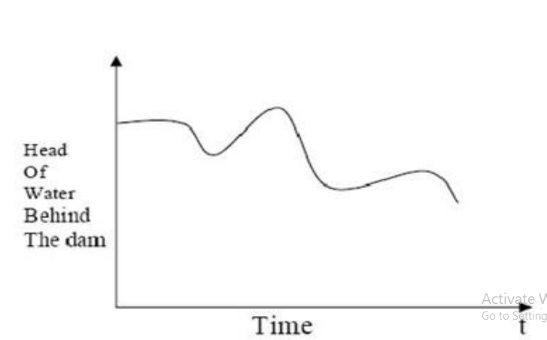
Continuous Systems

Slide 11
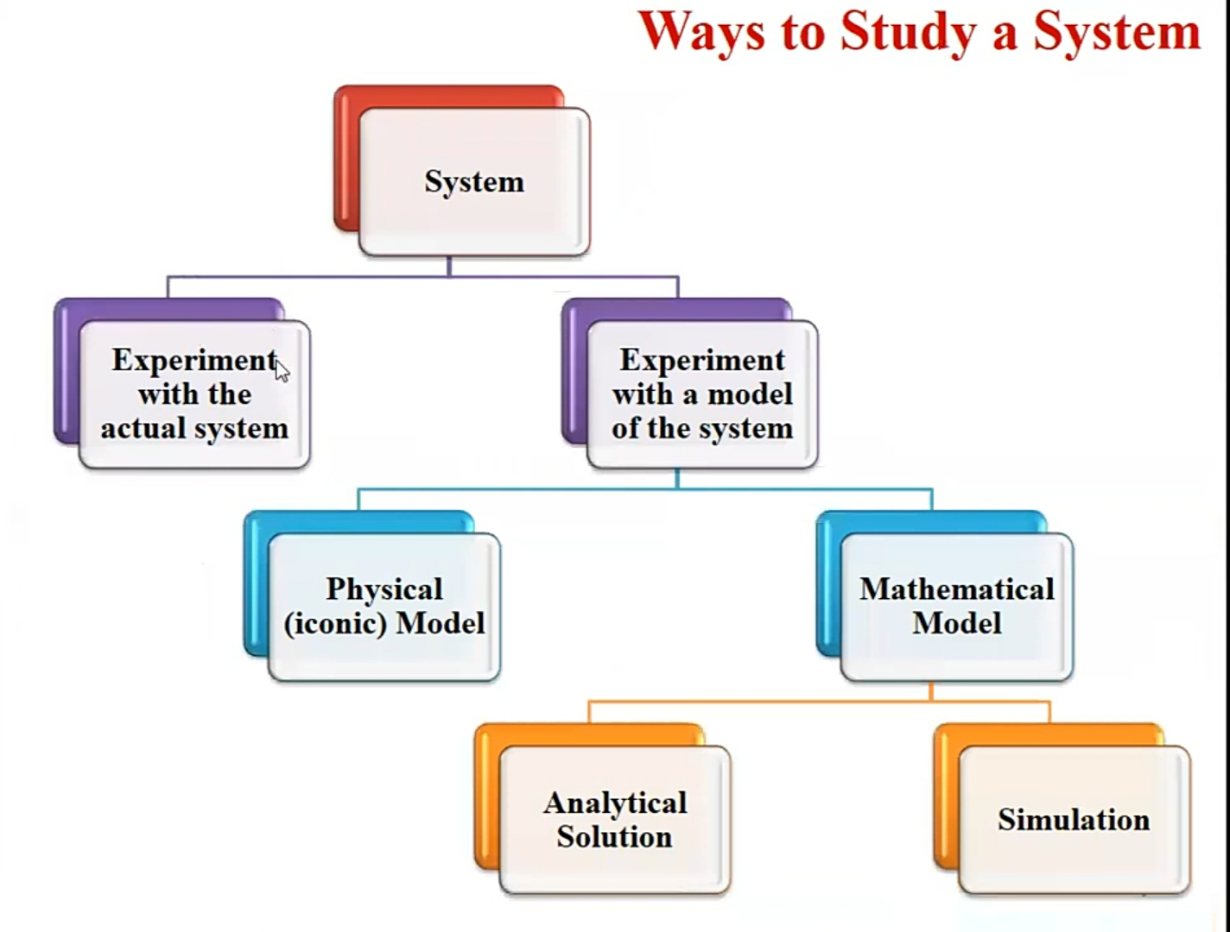

Slide 12
1.3 Model of System.,.
A model is defined as a representation of a system for the purpose of studying the system.
It is necessary to consider only those aspects of the system that affect the problem under investigation.
These aspects are represented in a model, and by definition it is a simplification of the system

Slide 13
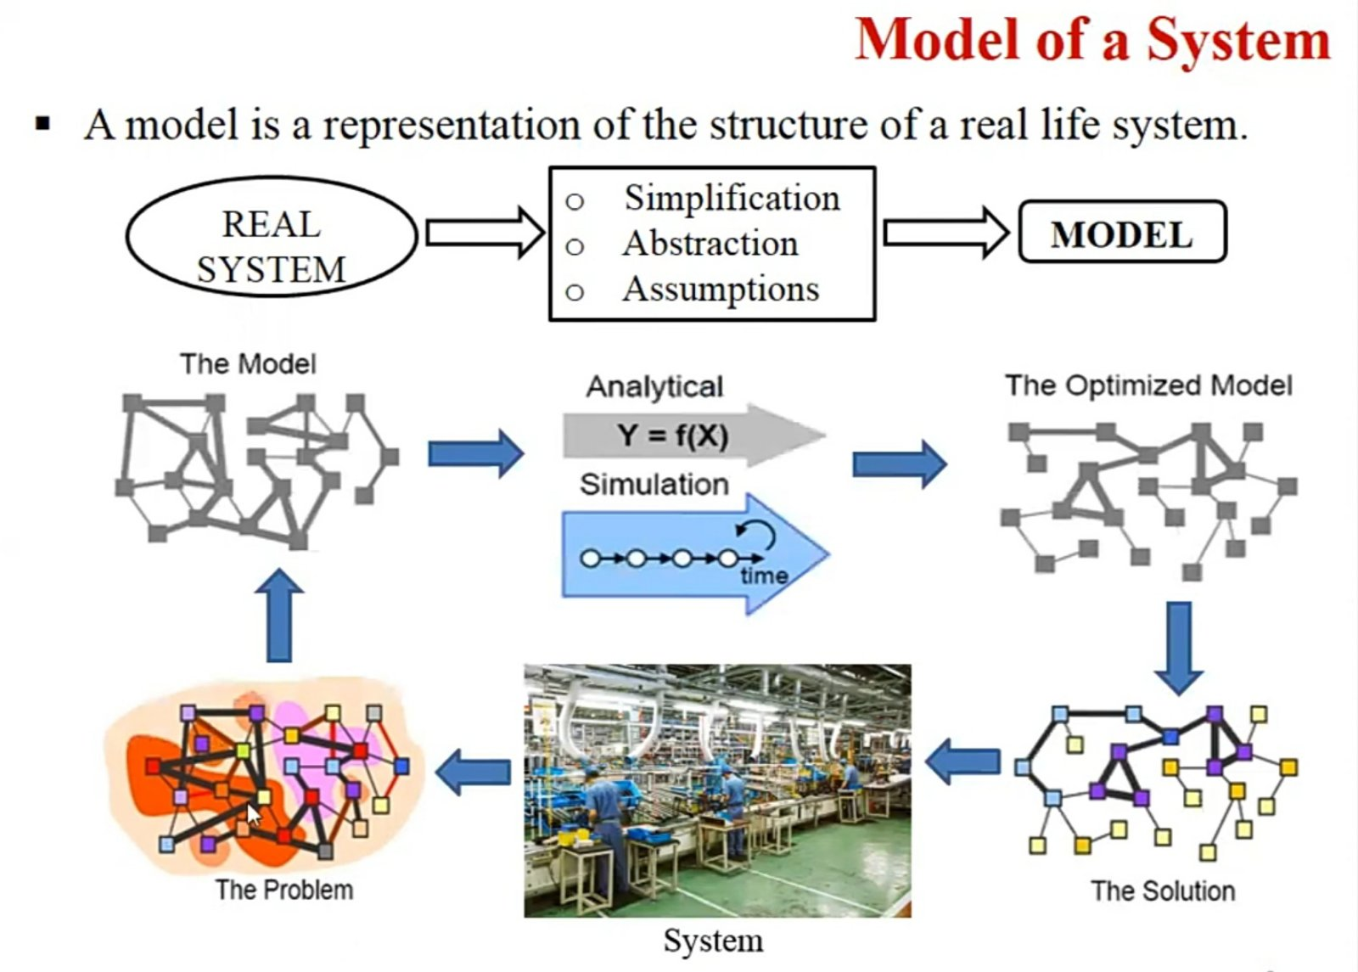
1.3 model of system

Slide 14
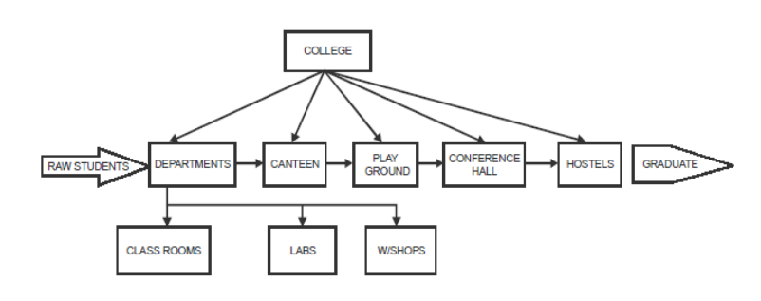
Principles used in modeling..
. Block building:
• The description of the system should be organized in a series of blocks to simplify the specifications of the interactions within the system.
• Each block represents a part of the system and the system as a whole can be described in terms of interconnections between blocks.

Slide 15
Principles used in modeling..
2. Relevance:
• The model should only include those aspects of the system that are relevant (applicable) to the study objectives.
3. Accuracy:
• The accuracy of the information gathered for the model should be considered.
4. Aggregation:
• A further factor to be considered as the extent to which the number of individual entities can be grouped together into larger entities.

Slide 16
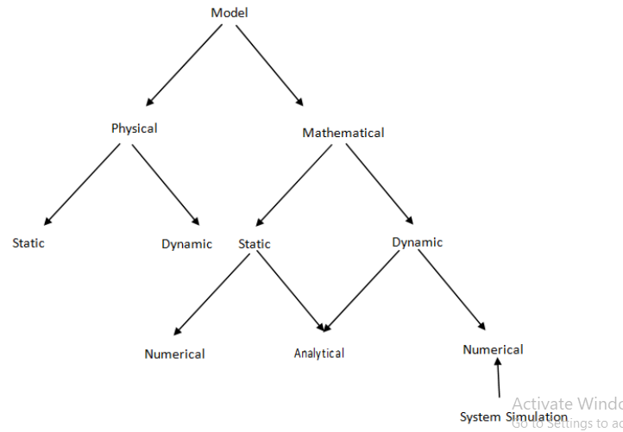
1.4 Types of model:

Slide 17
Types of system model:
• Physical models are based on some analogy between systems like mechanical and electrical. The system attributes are represented by such measurements like voltage.
• Mathematical models use symbolic notation and mathematical equations to represent the system attributes. The attributes represented by variables and activities by mathematical functions that inter-relate the variables.
• Static models can only show the values that system attributes take when the system is in balance
.Dynamic model , follow the changes over time that result from system activities.
• Applying analytical techniques means using the deductive (logical) reasoning of mathematical theory to solve a model. For E.g. linear differential equation
• Numerical methods involves applying conceptual (theoretical) procedures to solve equations.

Slide 18
1 . Static physical model
Represents a system at a particular point of time and also known as Monte- Carlo simulation.
In this model, the measurements are taken to represent attributes of the system being study under one set of equilibrium (balance) condition.
In this case, the measurement do not translate directly into system attribute values.
Well known laws of similitude are used to convert measurement on the scale model to the values that will occur in the real system.
For E.g. the flow of heat and the distribution of electric charge through space can be related by common equation.

Slide 19
2 . Dynamic physical model
Represents systems as they change over time. Ex: Simulation of a bank.
Dynamic physical models are ones which change with time or which are functions of time.
This model rely upon an analogy between the system being studied and some other system of different nature, the analogy usually depending upon an underlying similarities in the forces governing the behavior of the systems

Slide 20
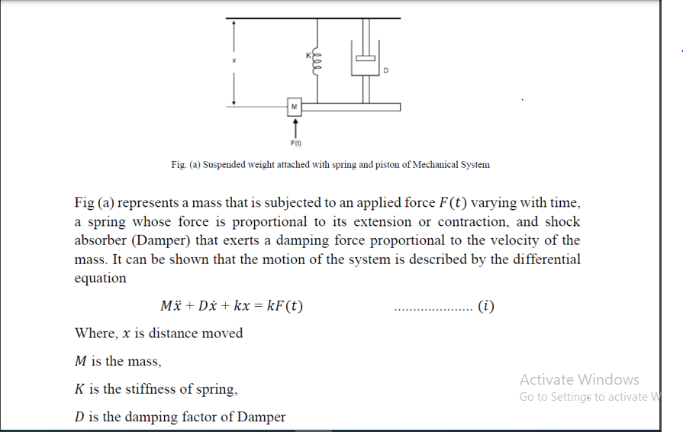

Slide 21
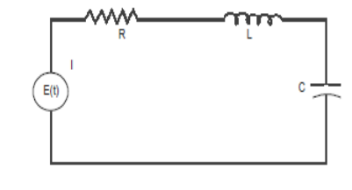
9
Fig. represents an electrical circuit with an inductance 𝐿, resistance 𝑅 and capacitance 𝐶 connected in series with a voltage source that varies in time according to function𝐸(𝑡). If 𝑞 is the charge on capacitor it can be shown that the barrier of the circuit is governed by following differential equation

Slide 22
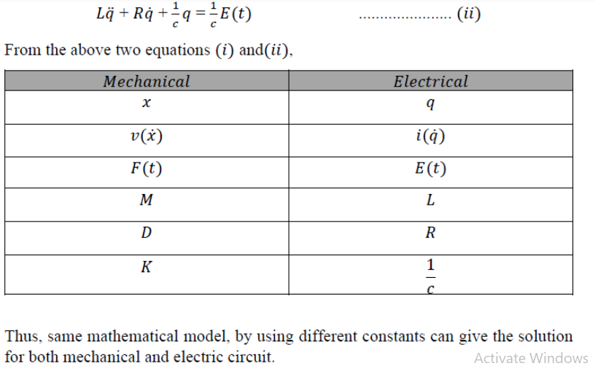

Slide 23
3. Static mathematical model
A static model gives the relationship between the system attributes when the system is in equilibrium (balance).
If the point of equilibrium is change by alternating any of the attribute values, the model enables the new values for all the attributes to be derived. But doesn't show the way in which they changed to their new value.
If mathematical model doesn't involve time i.e. system does not change with time, it is called static mathematical model of the system

Slide 24
9. Production runs and analysis
Actual running the simulation, collect and analyze the output.
10. Repetition
Repeat the experiments if necessary.
11. Document and report
Document and report the results
12. Implementation: Implement the simulated system in the real world if the simulation results show that it is advantageous to implement the new system or polic

Slide 25
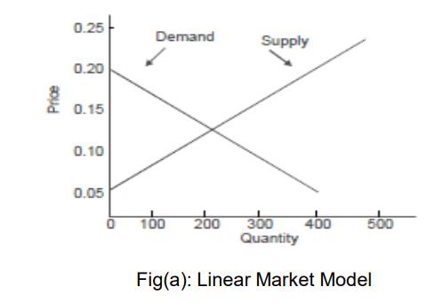
Static mathematical model… For e.g. we look at the case of static mathematical model from industry. In marketing a commodity generally there is a balance between supply and demand. Both factors depend on price. Demand for the commodity will be low when the price is high and it will increase as the price drops. If we take the simplistic linear case the relationship between demand (𝑄) and price (𝑃) might be represented by the straight line

Slide 26
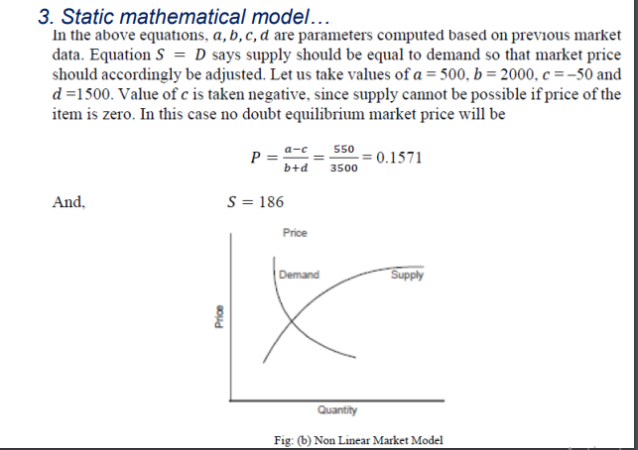
Static mathematical model… Let us model this situation mathematically. If we denote price by P, supply by S and demand by D, and assuming the price equation to be linear we have 𝐷 = 𝑎 − 𝑏𝑃 where a= demand price 𝑆 = 𝑐 + 𝑑𝑃 c= supply price 𝑆 = 𝐷

Slide 27
3. Static mathematical model…
In the first model we have taken simple linear case, but fig (b) might be complex.
In that case the solution may not be so simple. More usually, the demand and supply are depreciated by curves with slopes upward and downward respectively.
It may not be possible to express the relationships by equations that can be solved easily.
Some numerical or graphical methods are used to solve such relations. In addition, it is difficult to get the values of the coefficients of the model. Observations over the extended period of time, however, will establish the slopes (that is values of b and d) in the neighborhood of the equilibrium points.
These values will often fluctuate under the global and local economic conditions

Slide 28
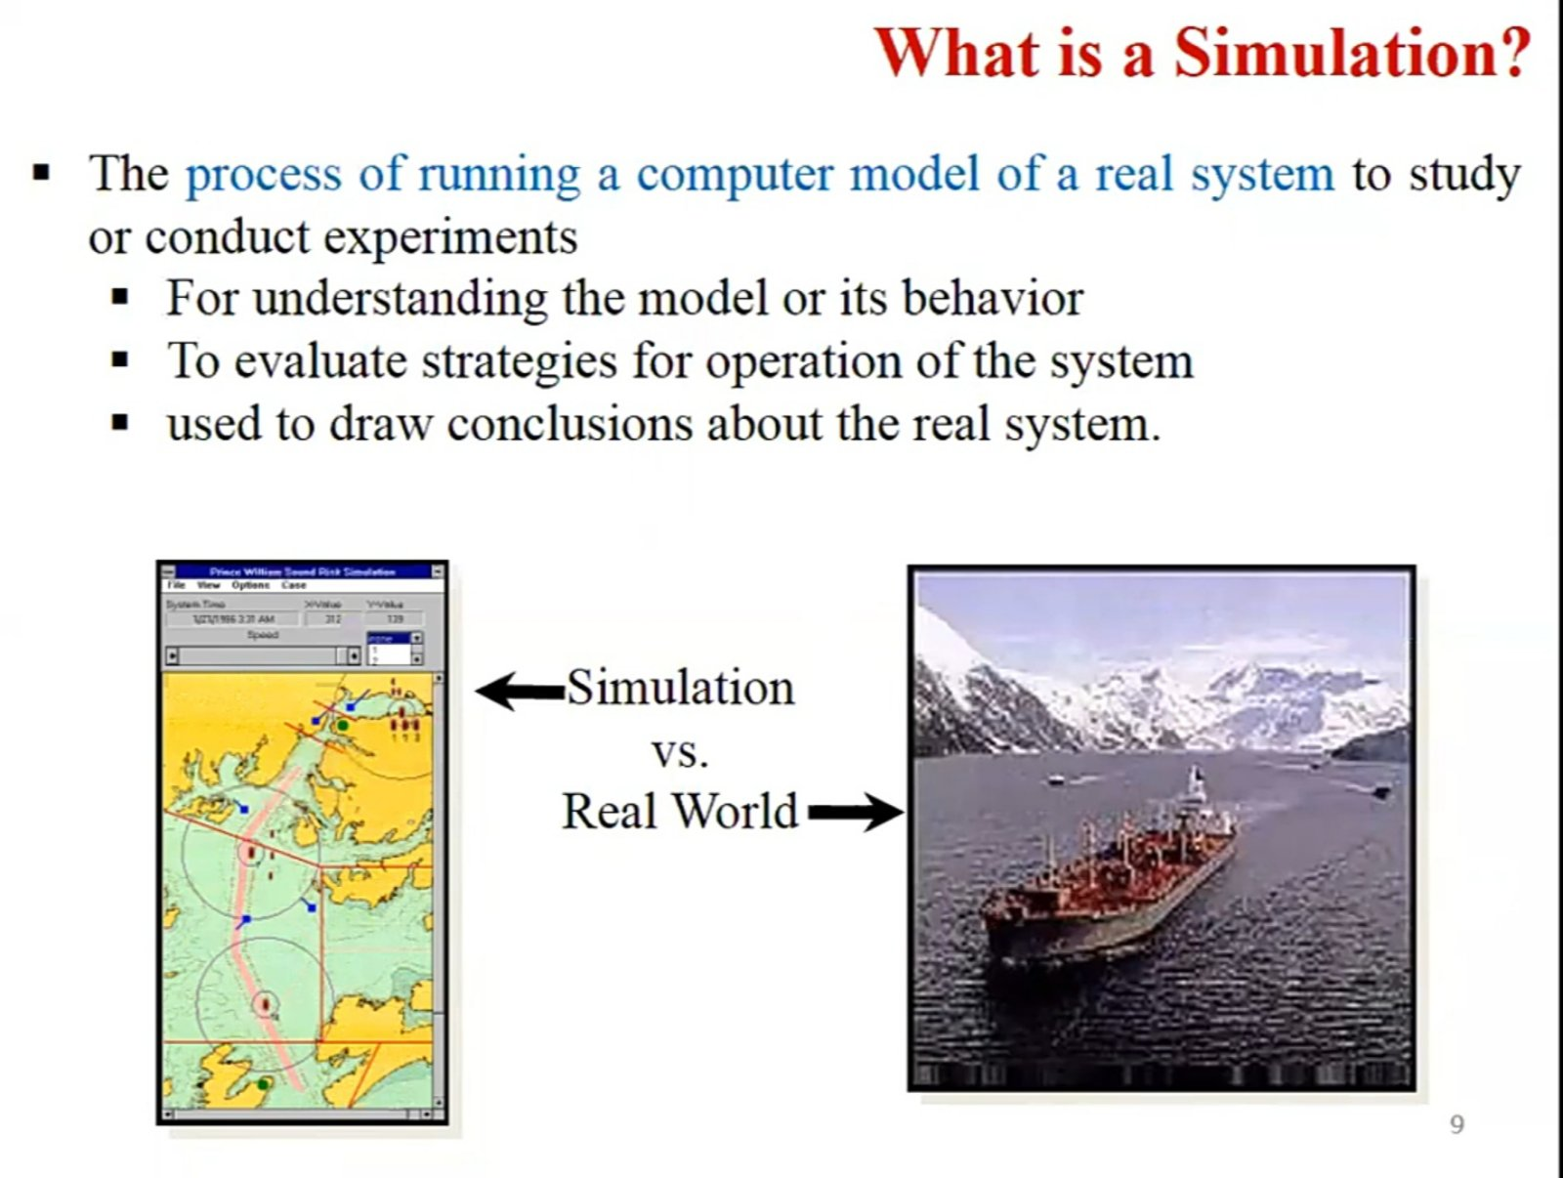

Slide 29
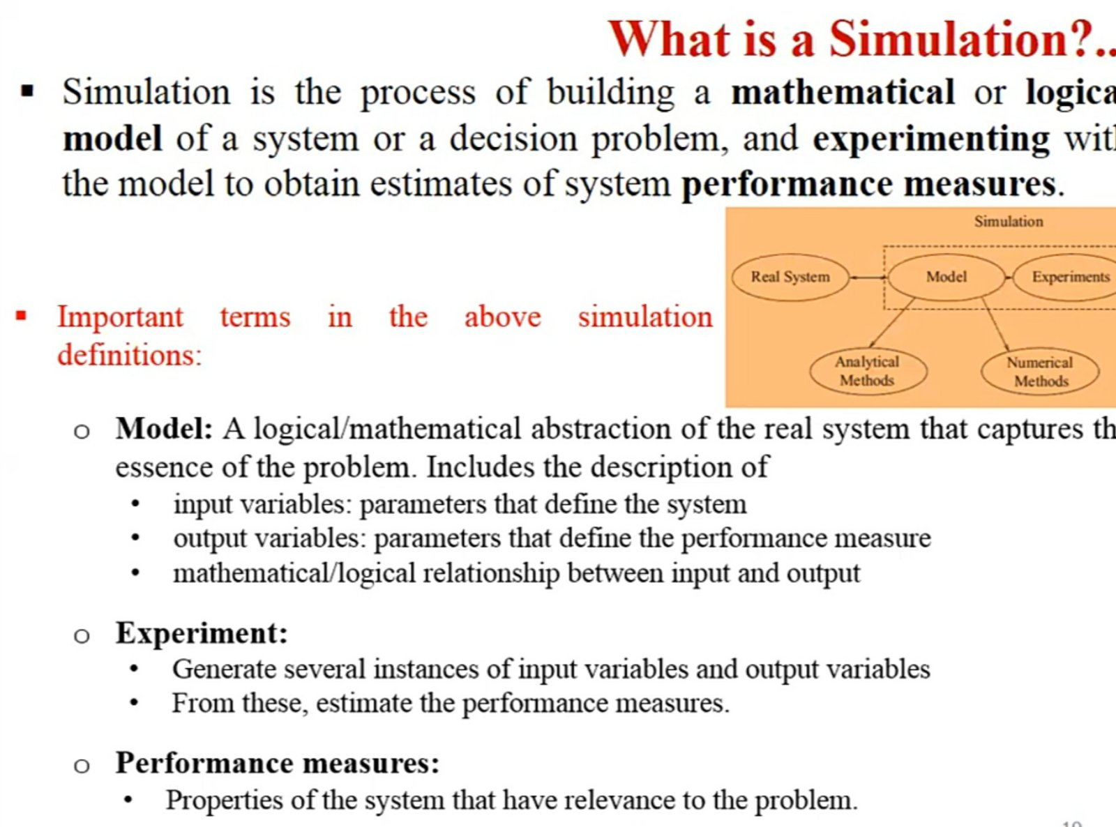

Slide 30
1.5 Computer simulation
is the running of a mathematical model on a computer, the model being designed to represent the behaviour of, or the outcome of, a real-world or physical system. The reliability of some mathematical models can be determined by comparing their results to the real-world outcomes they aim to predict. Computer simulations have become a useful tool for the mathematical modeling of many natural systems in physics (computational physics), astrophysics, climatology, chemistry, biology and manufacturing, as well as human systems in economics, psychology, social science, health care and engineering. Simulation of a system is represented as the running of the system's model. It can be used to explore and gain new insights into new technology and to estimate the performance of systems too complex for analytical solutions
There are many types of computer simulations; their common feature is the attempt to generate a sample of representative scenarios for a model in which a complete enumeration of all possible states of the model would be prohibitive or impossible

Slide 31
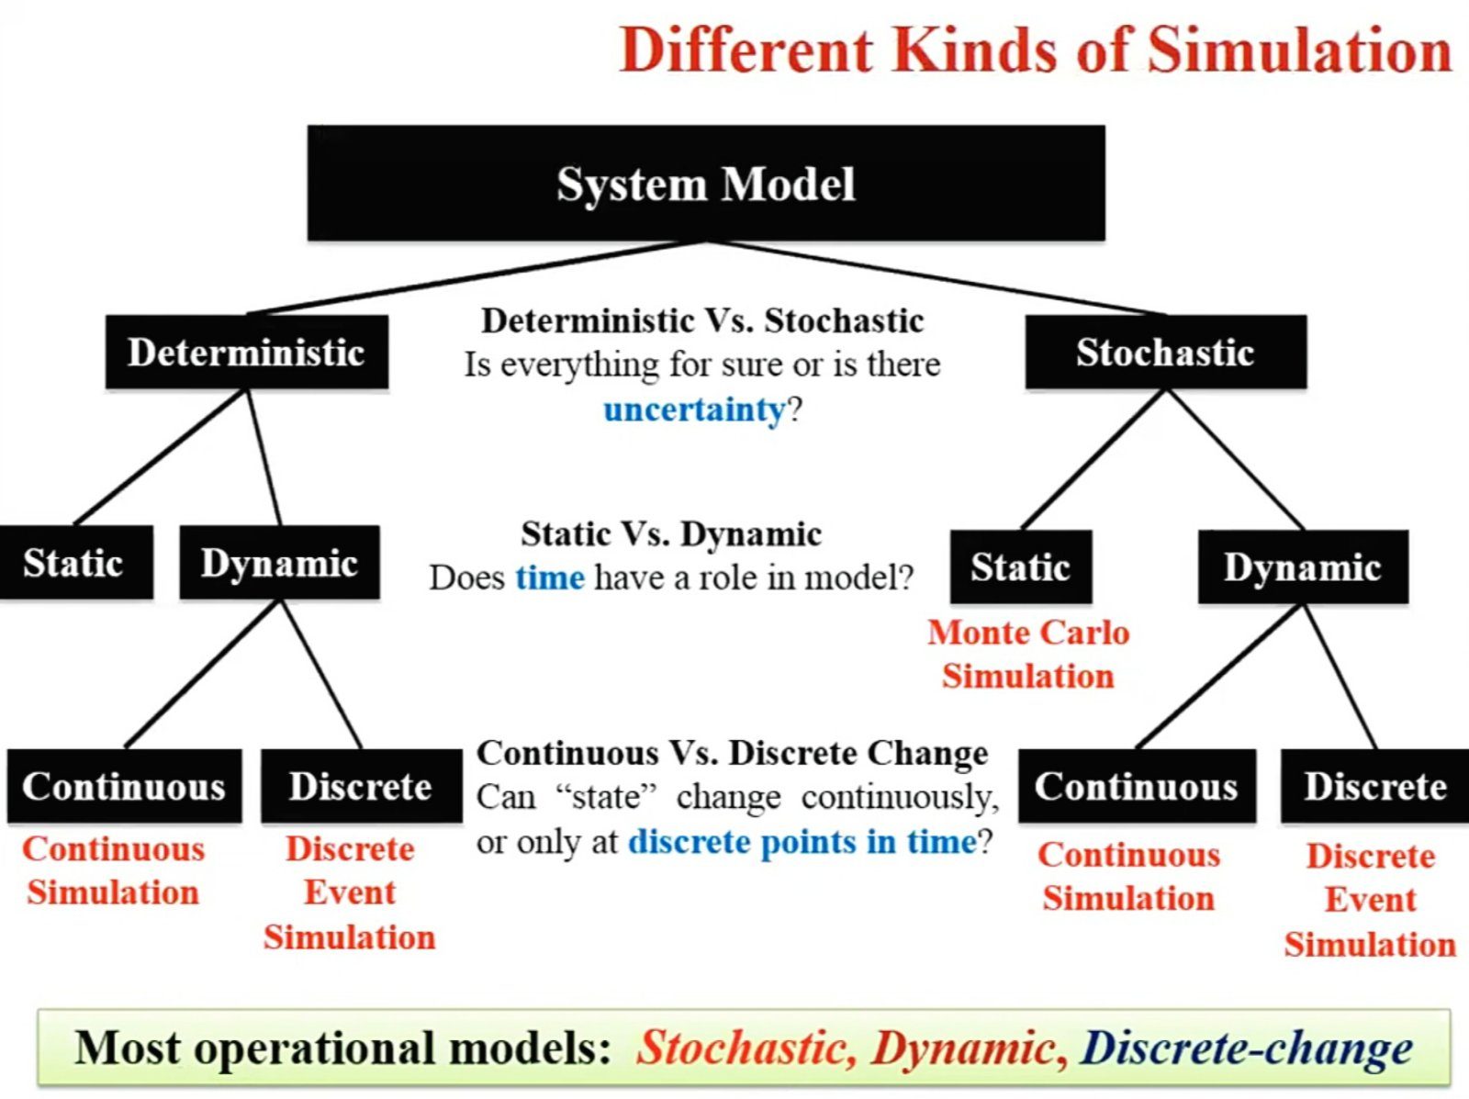

Slide 32
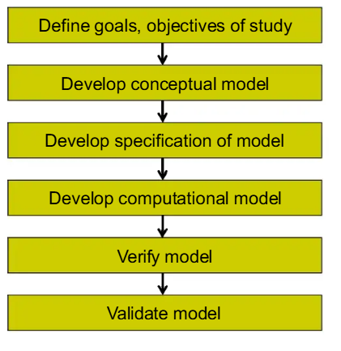
Model development life cycle
1. Define Goals & Objectives
Identify the purpose of the study
Decide what problem needs to be solved
2. Develop Conceptual Model
Create a simple logical representation of the system
Define relationships, variables, and assumptions
3. Develop Specification of Model
Convert conceptual ideas into detailed mathematical or logical form
Define inputs, outputs, and system rules clearly
4. Develop Computational Model
Implement the model using software or programming tools
Example: Python, MATLAB, simulation tools
5. Verify Model
Check whether the model is correctly implemented
Ensure there are no coding or logical errors
6. Validate Model
Compare model results with real-world data
Confirm the model is accurate and reliable

Slide 33
1.7Advantages of simulation
Simulation can also be used to study systems in the design stage.
Simulation models are run rather than solver.
New policies, operating procedures, decision rules, information flows, organizational procedures, and so on can be explored without disrupting ongoing operations of the real system.
New hardware designs, physical layouts, transportation systems, and so on can be tested without committing resources for their acquisition.
A simulation study can help in understanding how the system operates rather than how individuals think the system operates.
what-if" questions can be answered. Useful in the design of new system

Slide 34
Limitations/Disadvantages of the Simulation technique
Model building requires special training.
It is an art that is learned over time and through experience.
Simulation results can be difficult to interpret
Most simulation outputs are essentially random variables (they are usually based on random inputs), so it can be hard to distinguish whether an observation is a result of system interrelationships. of randomness.

Slide 35
1.8 Steps of simulation
1.Problem formulation
Clearly state the problem.
2. Setting of objectives and overall project plan
How we should approach the problem.
3. Model conceptualization
Establish a reasonable model.
4. Data collection
Collect the data necessary to run the simulation (such as arrival rate, arrival process, service discipline, service rate etc.).
5. Model translation
Convert the model into a programming language.
6. Verification
Verify the model by checking if the program works properly. Use common sense.
7. Validation
Check if the system accurately represent the real system.
8. Experimental design
How many runs? For how long? What kind of input variations?

Slide 36
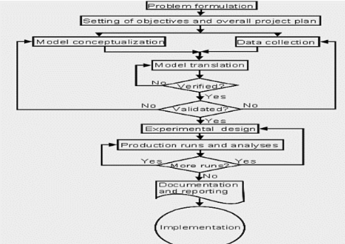

Slide 37
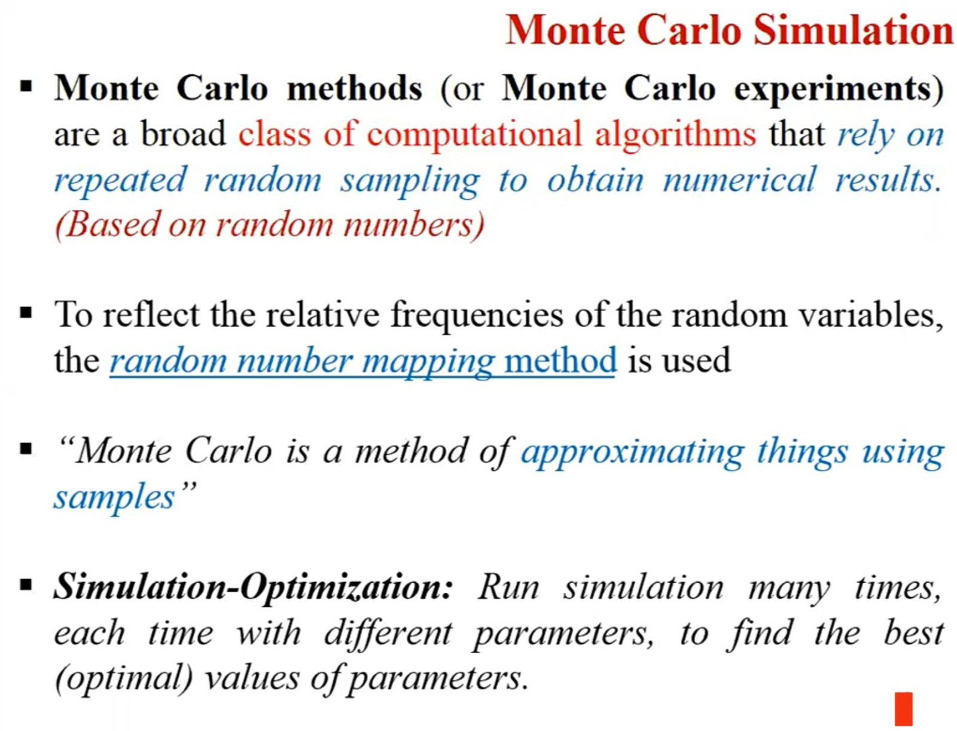

Slide 38
